Slide 1
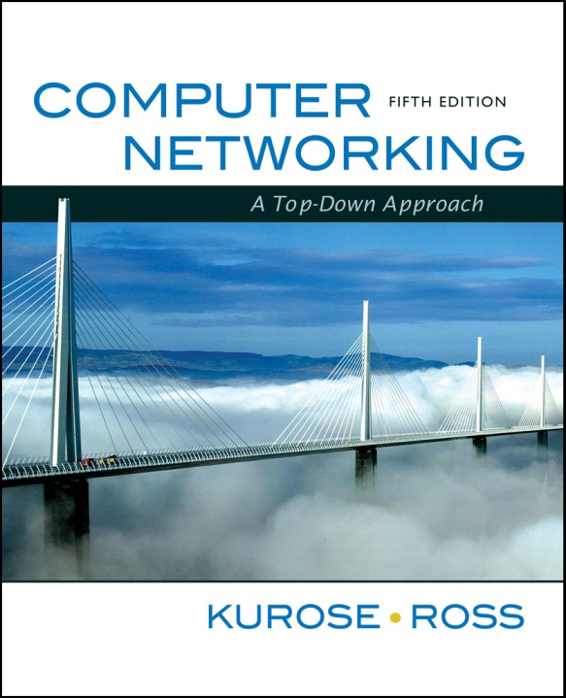
Wireless and Mobile Networks
Computer Networking: A Top Down Approach
5th edition.
Jim Kurose, Keith Ross
Addison-Wesley

Slide 2
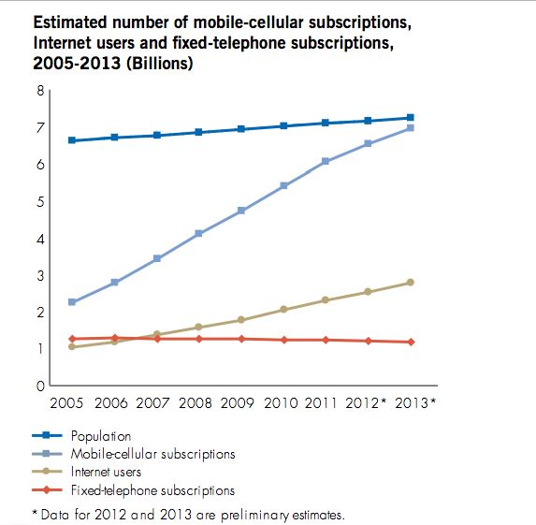
Wireless and Mobile Networks
two important (but different) challenges
  wireless: communication over wireless link
  mobility: handling the mobile user who changes point of attachment to network

Slide 3
Outline
Introduction
Wireless
IEEE 802.11 wireless LANs (“WiFi”)
Wireless cellular network
Mobility
Principles: addressing and routing to mobile users
Mobile IP
Mobility in cellular networks

Slide 4
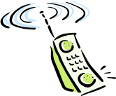

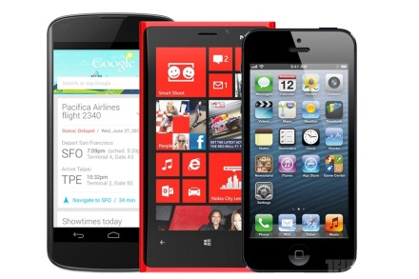
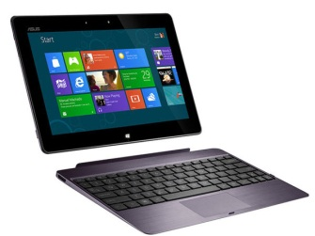
Elements of a wireless network
wireless hosts
laptop, PDA, smart phone
run applications
may be stationary (non-mobile) or mobile
  wireless does not always mean mobility
network
infrastructure

Slide 5
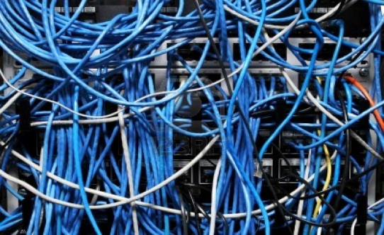
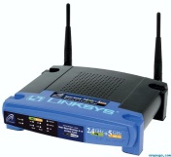
Elements of a wireless network
base station
typically connected to wired network
relay - responsible for sending packets between wired network and wireless host(s) in its “area”
  e.g., cell towers, 802.11 access points
network
infrastructure

Slide 6
Elements of a wireless network
wireless link
typically used to connect mobile(s) to base station
  also used as backbone link
multiple access protocol coordinates link access
various data rates, transmission distance
network
infrastructure

Slide 7
Characteristics of selected wireless link standards
200
802.11n
54
802.11a,g
802.11a,g point-to-point
data
5-11
802.11b
802.16 (WiMAX)
4
Data rate (Mbps)
1
802.15
.384
UMTS/WCDMA, CDMA2000
3G
.056
IS-95, CDMA, GSM
2G
Indoor
10-30m
Outdoor
50-200m
Mid-range
outdoor
200m – 4 Km
Long-range
outdoor
5Km – 20 Km

Slide 8

Characteristics of selected wireless link standards
200
802.11n
54
802.11a,g
802.11a,g point-to-point
data
5-11
802.11b
802.16 (WiMAX)
4
Data rate (Mbps)
1
802.15
.384
UMTS/WCDMA, CDMA2000
3G
.056
IS-95, CDMA, GSM
2G
Indoor
10-30m
Outdoor
50-200m
Mid-range
outdoor
200m – 4 Km
Long-range
outdoor
5Km – 20 Km

Slide 9
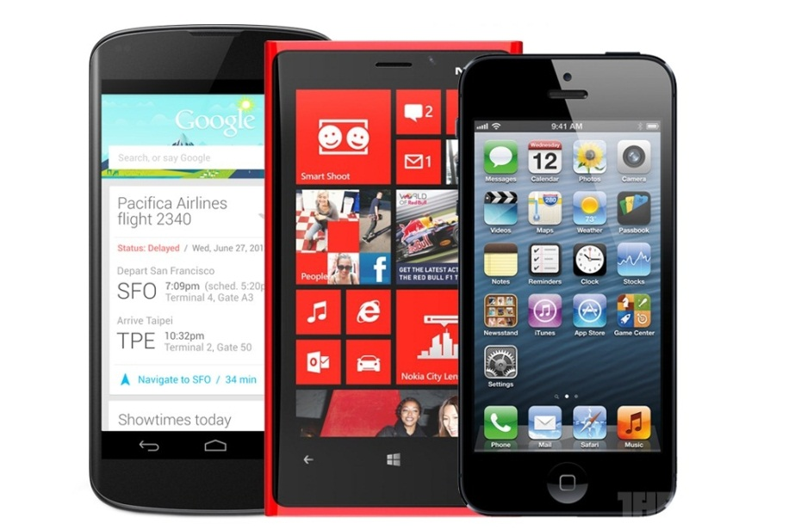
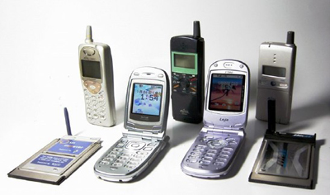
Characteristics of selected wireless link standards
200
802.11n
54
802.11a,g
802.11a,g point-to-point
data
5-11
802.11b
802.16 (WiMAX)
4
Data rate (Mbps)
1
802.15
.384
UMTS/WCDMA, CDMA2000
3G
.056
IS-95, CDMA, GSM
2G
Indoor
10-30m
Outdoor
50-200m
Mid-range
outdoor
200m – 4 Km
Long-range
outdoor
5Km – 20 Km

Slide 10
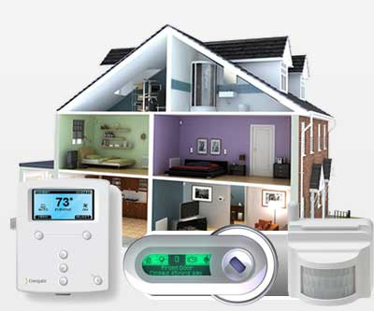
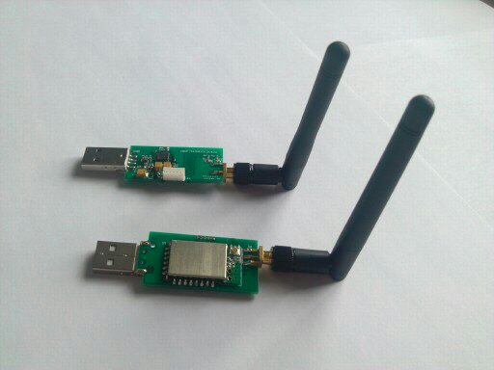
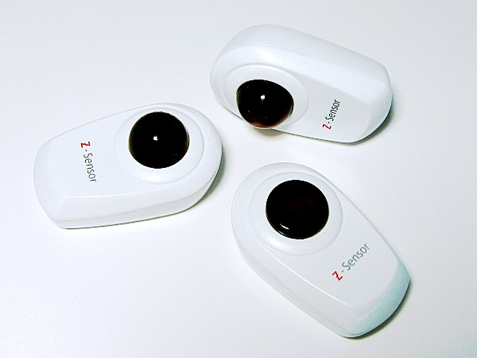
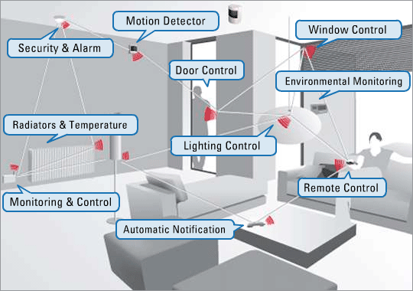
Characteristics of selected wireless link standards
200
802.11n
54
802.11a,g
802.11a,g point-to-point
data
5-11
802.11b
802.16 (WiMAX)
4
Data rate (Mbps)
1
802.15
.384
UMTS/WCDMA, CDMA2000
3G
.056
IS-95, CDMA, GSM
2G
Indoor
10-30m
Outdoor
50-200m
Mid-range
outdoor
200m – 4 Km
Long-range
outdoor
5Km – 20 Km

Slide 11
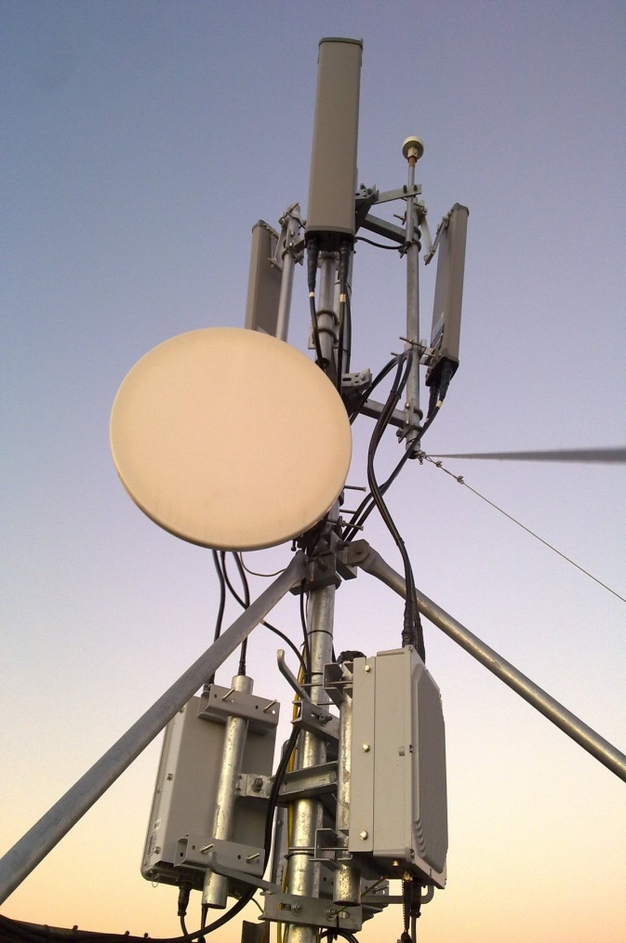
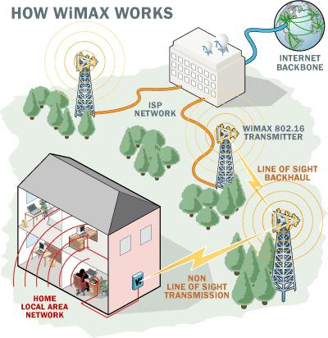
Characteristics of selected wireless link standards
200
802.11n
54
802.11a,g
802.11a,g point-to-point
data
5-11
802.11b
802.16 (WiMAX)
4
Data rate (Mbps)
1
802.15
.384
UMTS/WCDMA, CDMA2000
3G
.056
IS-95, CDMA, GSM
2G
Indoor
10-30m
Outdoor
50-200m
Mid-range
outdoor
200m – 4 Km
Long-range
outdoor
5Km – 20 Km

Slide 12
Wireless Link Characteristics
Differences from wired link ….
  decreased signal strength: radio signal attenuates as it propagates through matter (path loss)
  interference from other sources: standardized wireless network frequencies (e.g., 2.4 GHz) shared by other devices (e.g., phone); devices interfere as well
  multipath propagation: radio signal reflects off objects ground, arriving at destination at slightly different times
…. make communication across (even a point to point) wireless link much more “difficult”

Slide 13
Outline
Introduction
Wireless
IEEE 802.11 wireless LANs (“WiFi”)
Wireless cellular network
Mobility
Principles: addressing and routing to mobile users
Mobile IP
Mobility in cellular networks

Slide 14
IEEE 802.11 Wireless LAN
802.11b
  2.4-5 GHz unlicensed spectrum
  up to 11 Mbps
  Direct Sequence Spread Spectrum (DSSS) in physical layer
802.11a
  5-6 GHz range
  up to 54 Mbps
802.11g
  2.4-5 GHz range
  up to 54 Mbps
802.11n: multiple antennae
  2.4-5 GHz range
  up to 200 Mbps

Slide 15
802.11 LAN Architecture
wireless host communicates with base station
  base station = access point (AP)
Basic Service Set (BSS) (aka “cell”) in infrastructure mode contains:
  wireless hosts
  access point (AP): base station
  ad hoc mode: hosts only
Internet
hub, switch
or router
AP
BSS 1
AP
BSS 2

Slide 16
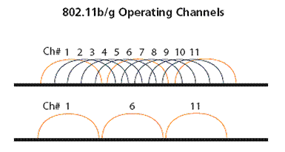
802.11: Channels, association
802.11b: 2.4GHz-2.485GHz spectrum divided into 11 channels at different frequencies
  AP admin chooses frequency for AP
  interference possible: channel can be same as that chosen by neighboring AP!

Slide 17
802.11: Channels, association
802.11b: 2.4GHz-2.485GHz spectrum divided into 11 channels at different frequencies
  AP admin chooses frequency for AP
  interference possible: channel can be same as that chosen by neighboring AP!
host: must associate with an AP
  scans channels, listening for beacon frames containing AP’s name (SSID) and MAC address
  selects AP to associate with
  may perform authentication (security purpose)
  will typically run DHCP to get IP address in AP’s subnet

Slide 18
802.11: passive/active scanning
BBS 1
BBS 2
BBS 1
BBS 2
AP 1
AP 2
AP 1
1
AP 2
1
1
2
2
2
3
3
4
H1
H1
Passive Scanning:
beacon frames sent from APs
association Request frame sent: H1 to selected AP
association Response frame sent: Selected AP to H1
Active Scanning:
Probe Request frame broadcast from H1
Probes response frame sent from APs
Association Request frame sent: H1 to selected AP
Association Response frame sent: selected AP to H1

Slide 19
IEEE 802.11: multiple access
avoid collisions: 2⁺ nodes transmitting at same time
802.11: CSMA - sense before transmitting
  don’t collide with ongoing transmission by other node
    802.11: NO collision detection! (Ethernet: CSMA/CD)
  difficult to receive (sense collisions) when transmitting due to weak received signals (fading)
  can’t sense all collisions in any case: hidden terminal, fading

Slide 20
IEEE 802.11: multiple access
A
B
C
C
A’s signal
strength
C’s signal
strength
B
A
Hidden terminal problem
B, A hear each other
B, C hear each other
A, C can not hear each other
means A, C unaware of their interference at B
space
Signal attenuation:
B, A hear each other
B, C hear each other
A, C can not hear each other interfering at B
Avoid collisions CSMA/C(ollision)A(voidance)

Slide 21
IEEE 802.11 MAC Protocol: CSMA/CA
802.11 sender
1 if sense channel idle for DIFS then
transmit entire frame (no CD)
2 if sense channel busy then
start random backoff time
timer counts down while channel idle
transmit when timer expires
if no ACK, increase random backoff interval, repeat 2
802.11 receiver
- if frame received OK
return ACK after SIFS (ACK needed due to hidden terminal problem)
sender
receiver
DIFS
data
SIFS
ACK

Slide 22
Avoiding collisions (more)
idea: allow sender to “reserve” channel rather than random access of data frames: avoid collisions of long data frames
sender first transmits small request-to-send (RTS) packets to BS using CSMA
  RTSs may still collide with each other (but they’re short)
BS broadcasts clear-to-send CTS in response to RTS
CTS heard by all nodes
  sender transmits data frame
  other stations defer transmissions
avoid data frame collisions completely
using small reservation packets!

Slide 23
Collision Avoidance: RTS-CTS exchange
A
B
AP
RTS(B)
RTS(A)
reservation collision
RTS(A)
CTS(A)
CTS(A)
DATA (A)
defer
time
ACK(A)
ACK(A)

Slide 24
802.11 frame: addressing
2
2
6
6
6
2
6
0 - 2312
4
frame
control
duration
address
1
address
2
address
3
seq
control
address
4
payload
CRC
Address 4: used only in ad hoc mode
Address 1: MAC address
of wireless host or AP
to receive this frame
Address 3: MAC address
of router interface to which AP is attached
Address 2: MAC address
of wireless host or AP
transmitting this frame

Slide 25
802.11 frame: addressing
Internet
H1
R1
router
AP
R1 MAC addr H1 MAC addr
dest. address
source address
Ethernet frame
AP MAC addr H1 MAC addr R1 MAC addr
address 1
address 2
address 3
802.11 frame

Slide 26
802.11: mobility within same subnet
H1 remains in same IP subnet: IP address can remain same
switch: which AP is associated with H1?
  self-learning : switch will see frame from H1 and “remember” which switch port can be used to reach H1
router
hub or
switch
BBS 1
AP 1
AP 2
H1
BBS 2

Slide 27


Cellular network architecture
MSC
connects cells to wide area net
manages call setup
handles mobility
cell
covers geographical region
base station (BS) similar to 802.11 AP
mobile users attach to network through BS
air-interface: physical and link layer protocol between mobile and BS
Mobile
Switching
Center
Public telephone
network, and
Internet
Mobile
Switching
Center
wired network

Slide 28

Cellular network architecture
correspondent
wired public telephone
network
MSC
MSC
MSC
MSC
MSC
different cellular networks,
operated by different providers

Slide 29
Cellular networks: the first hop
Two techniques for sharing mobile-to-BS radio spectrum
combined FDMA/TDMA: divide spectrum in frequency channels, divide each channel into time slots
CDMA: code division multiple access
time slots
frequency
bands
channel output Z_{i,m}
Z_{i,m}= d_{i}.c_{m}
data
bits
d₀ = 1
1
1
1
1
1
d₁ = -1
1
1
1
-
-
-
-
1
-
-
-
1
1
-
1
1
1
1
1
1
slot 1
channel
output
slot 0
channel
output
1
1
1
1
1
code
1
1
-
-
-
1
1
-
1
1
-
-
-
1
1
-
1
1
slot 1
slot 0

Slide 30
Cellular standards: brief survey
2G systems: voice channels
IS-136 TDMA: combined FDMA/TDMA (north america)
GSM (global system for mobile communications): combined FDMA/TDMA
  most widely deployed
IS-95 CDMA: code division multiple access
CDMA-2000
TDMA/FDMA
GPRS
EDGE
UMTS
IS-136
GSM
IS-95
Don’t drown in a bowl of alphabet soup: use this for reference only

Slide 31
Cellular standards: brief survey
2.5 G systems: voice and data channels
for those who can’t wait for 3G service: 2G extensions
general packet radio service (GPRS)
  evolved from GSM
  data sent on multiple channels (if available)
enhanced data rates for global evolution (EDGE)
  also evolved from GSM, using enhanced modulation
  data rates up to 384K
CDMA-2000 (phase 1)
  data rates up to 144K
  evolved from IS-95
6: Wireless and Mobile Networks
6-<number>

Slide 32
2G (voice) network architecture
Base station system (BSS)
MSC
BTS
BSC
G
Public switched
telephone
network
Gateway
MSC
Legend
Base transceiver station (BTS)
Base station controller (BSC)
Mobile Switching Center (MSC)
Mobile subscribers

Slide 33
2.5G (voice+data) network architecture
MSC
BSC
G
Public switched
telephone
network
Gateway
MSC
G
Public
Internet
Key insight: new cellular data
network operates in parallel
with existing cellular voice network
voice network unchanged in core
data network operates in parallel
SGSN
GGSN
Serving GPRS Support Node (SGSN)
Gateway GPRS Support Node (GGSN)

Slide 34
Cellular standards: brief survey
3G systems: voice/data
  Universal Mobile Telecommunications Service (UMTS)
  CDMA in TDMA slots
  data service: up to 14 Mbps
4G systems: voice+data
  all-IP network: voice in data packets
  new wireless access technologies: OFDM, MIMO, etc.
  data rate: up to 300Mbps

Slide 35
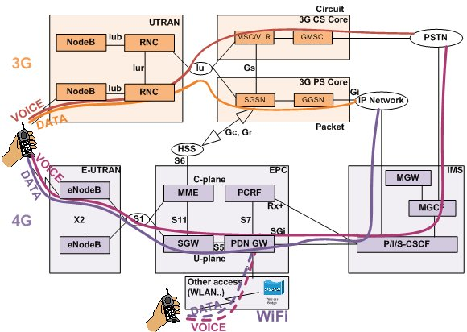
Cellular standards: brief survey
Figure from NIL Data Communications
Notes:
Voice and data bearer paths in Universal Mobile Telecommunication System (UMTS) and LTE network architectures
When comparing the voice and data bearer paths in 3G and 4G network architectures, VoLTE uses a few new nodes:
Home Subscriber Server (HSS) performs AAA and subscriber database functionality, eliminating the need for a separate Radius server
The Policy and Charging Rules Function (PCRF) server is an important element, taking care of the direct control of resources (quality of service) according to user profile
Mobility Management Entity (MME) has a role similar to that of the Serving GPRS Support Node (SGSN) in the 3G packet core, except that it only carries the signalling path
Serving GW (SGW) has inherited the SGSN's bearer role in 4G, transporting large amounts of traffic
Packet Data Network Gateway (PDN GW) has replaced the Gateway GPRS Support Node (GGSN) in the 3G packet core, thus having the Network Access Server (NAS) role
eNodeB serves in 4G instead of NodeB and Radio Network Controller (RNC) in 3G

Slide 36
Outline
Introduction
Wireless
IEEE 802.11 wireless LANs (“WiFi”)
Wireless cellular network
Mobility
Principles: addressing and routing to mobile users
Mobile IP
Mobility in cellular networks

Slide 37
What is mobility?
spectrum of mobility, from the network perspective:
no mobility
high mobility
mobile wireless user,
using same point of access
mobile user, connecting/ disconnecting from network using DHCP.
mobile user, passing through multiple points of access while maintaining ongoing connections (like cell phone)

Slide 38

Mobility: vocabulary
home network: permanent “home” of mobile
(e.g., 128.119.40/24)
home agent: entity that will perform mobility functions on behalf of mobile, when mobile is remote
wide area network
Permanent address: address in home network, can always be used to reach mobile
e.g., 128.119.40.186
correspondent

Slide 39
Mobility: vocabulary
visited network: network in which mobile currently resides (e.g., 79.129.13/24)
Permanent address: remains constant (e.g., 128.119.40.186)
Care-of-address: address in visited network.
(e.g., 79,129.13.2)
wide area network
foreign agent: entity in visited network that performs mobility functions on behalf of mobile.
correspondent: wants to communicate with mobile

Slide 40
Mobility: approaches
Let routing handle it: routers advertise permanent address of mobile-nodes-in-residence via usual routing table exchange.
  routing tables indicate where each mobile located
  no changes to end-systems
Let end-systems handle it:
  indirect routing: communication from correspondent to mobile goes through home agent, then forwarded to remote
  direct routing: correspondent gets foreign address of mobile, sends directly to mobile

Slide 41
Mobility: approaches
Let routing handle it: routers advertise permanent address of mobile-nodes-in-residence via usual routing table exchange.
  routing tables indicate where each mobile located
  no changes to end-systems
Let end-systems handle it:
  indirect routing: communication from correspondent to mobile goes through home agent, then forwarded to remote
  direct routing: correspondent gets foreign address of mobile, sends directly to mobile
not
scalable
to millions of
mobiles

Slide 42
Mobility: registration
visited network
home network
1
2
wide area network
mobile contacts foreign agent on entering visited network
foreign agent contacts home agent home: “this mobile is resident in my network”
End result:
Foreign agent knows about mobile
Home agent knows location of mobile

Slide 43
Mobility via Indirect Routing
foreign agent receives packets, forwards to mobile
home agent intercepts packets, forwards to foreign agent
visited
network
home
network
3
wide area network
2
1
correspondent addresses packets using home address of mobile
4
mobile replies directly to correspondent

Slide 44
Indirect Routing: comments
Mobile uses two addresses:
  permanent address: used by correspondent (hence mobile location is transparent to correspondent)
  care-of-address (Foreign address): used by home agent to forward datagrams to mobile
foreign agent functions may be done by mobile itself
triangle routing: correspondent-home-network-mobile
  inefficient when
  correspondent, mobile
  are in same network

Slide 45
Indirect Routing: moving between networks
suppose mobile user moves to another network
  registers with new foreign agent
  new foreign agent registers with home agent
  home agent update care-of-address for mobile
  packets continue to be forwarded to mobile (but with new care-of-address)
mobility, changing foreign networks transparent: on going connections can be maintained!

Slide 46
Mobility via Direct Routing
foreign agent receives packets, forwards to mobile
correspondent forwards to foreign agent
visited
network
home
network
4
wide area network
2
3
correspondent requests, receives foreign address of mobile
1
4
mobile replies directly to correspondent

Slide 47
Mobility via Direct Routing: comments
overcome triangle routing problem
non-transparent to correspondent: correspondent must get care-of-address from home agent
  what if mobile changes visited network?

Slide 48
Accommodating mobility with direct routing
anchor foreign agent: FA in first visited network
data always routed first to anchor FA
when mobile moves: new FA arranges to have data forwarded from old FA (chaining)
foreign net visited
at session start
anchor
foreign
agent
wide area network
2
1
4
5
3
new
foreign
network
correspondent
agent
new foreign
agent
correspondent

Slide 49
Mobile IP (in the internet)
IETF RFC 3344
has many features we’ve seen:
  home agents, foreign agents, foreign-agent registration, care-of-addresses, encapsulation (packet-within-a-packet)

Slide 50

Mobile IP: registration

Slide 51
Mobile IP: indirect routing
foreign-agent-to-mobile packet
packet sent by home agent to foreign agent: a packet within a packet (tunneling)
dest: 128.119.40.186
dest: 79.129.13.2
dest: 128.119.40.186
Permanent address: 128.119.40.186
Care-of address: 79.129.13.2
dest: 128.119.40.186
packet sent by correspondent

Slide 52
Handling mobility in cellular networks
home network: network of cellular provider you subscribe to (e.g., SingTel, M1)
  home location register (HLR): database in home network containing permanent cell phone #, profile information (services, preferences, billing), information about current location (could be in another network)
visited network: network in which mobile currently resides
  visitor location register (VLR): database with entry for each user currently in network
  could be home network

Slide 53
GSM: indirect routing to mobile
HLR
home
network
2
correspondent
home
Mobile
Switching
Center
home MSC consults HLR,
gets roaming number of
mobile in visited network
1
call routed
to home network
3
Public switched
telephone
network
VLR
Mobile
Switching
Center
4
home MSC sets up 2nd leg of call
to MSC in visited network
mobile
user
MSC in visited network completes
call through base station to mobile
visited
network

Slide 54
Mobility: GSM versus Mobile IP
GSM element |  | Comment on GSM element | Mobile IP element
Home system | Network to which mobile user’s permanent phone number belongs |  |  | Home network
Gateway Mobile Switching Center, or “home MSC”. Home Location Register (HLR) | Home MSC: point of contact to obtain routable address of mobile user. HLR: database in home system containing permanent phone number, profile information, current location of mobile user, subscription information |  |  | Home agent
Visited network | Network other than home system where mobile user is currently residing |  |  | Visited network
Visited Mobile services Switching Center. Visitor Location Record (VLR) | Visited MSC: responsible for setting up calls to/from mobile nodes in cells associated with MSC. VLR: temporary database entry in visited system, containing subscription information for each visiting mobile user |  |  | Foreign agent
Mobile Station Roaming Number (MSRN), or “roaming number” | Routable address for telephone call segment between home MSC and visited MSC, visible to neither the mobile nor the correspondent. |  |  | Care-of-address

Slide 55
Wireless, mobility: impact on higher layer protocols
logically, impact should be minimal …
  best effort service model remains unchanged
  TCP and UDP can (and do) run over wireless, mobile
… but performance-wise:
  packet loss/delay due to bit-errors (discarded packets, delays for link-layer retransmissions), and handoff
  TCP interprets loss as congestion, will decrease congestion window un-necessarily
  delay impairments for real-time traffic
  limited bandwidth of wireless links

